Slide 1

OOP
OOP
Class Object Attributes, @classmethods & @staticmethods

Slide 2
01
Class Object Attribute

Slide 3
Introduction
A class object attribute is a variable that belongs to a certain class, and not a particular object. Every instance of this class shares the same variable. These attributes are usually defined outside the __init__ constructor. An instance/object attribute is a variable that belongs to one (and only one) object.

Slide 4
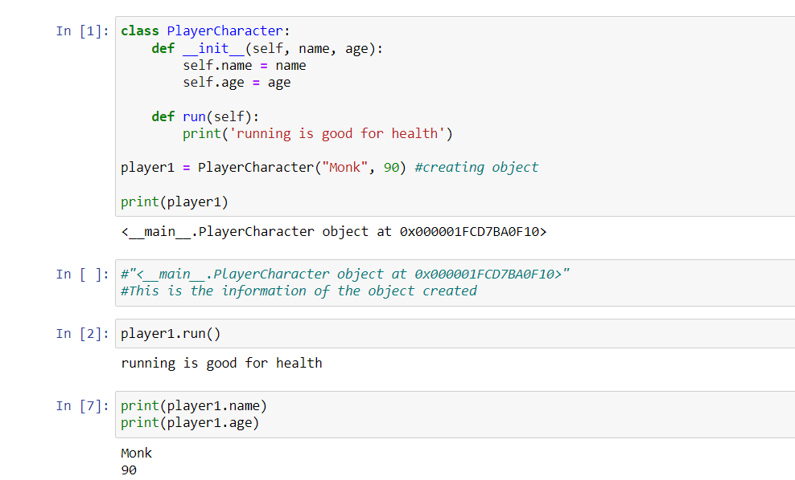

Slide 5
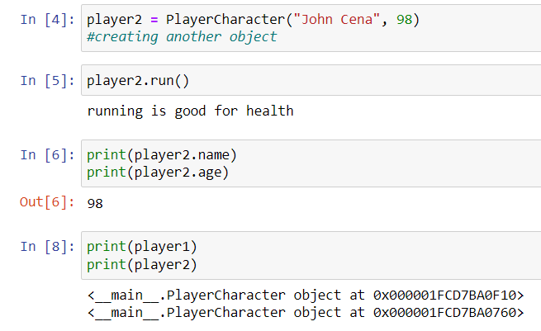

Slide 6
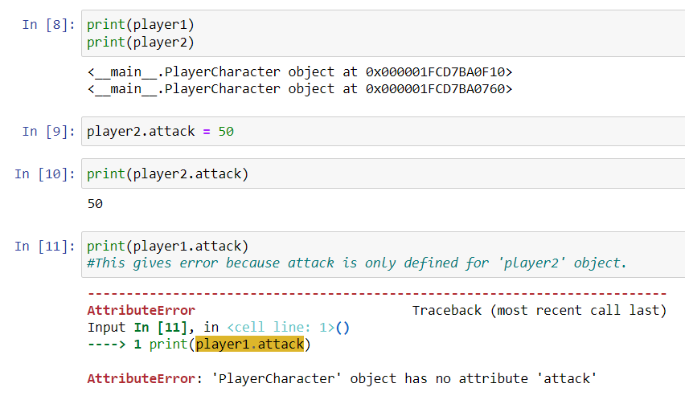

Slide 7
Till now, we created a class, assigned it with attributes and methods & looked up ways to handle them.
But in Example_1, we can see that “player1.attack” gives us an error because it is externally defined outside of class for “Player2” only.

Slide 8
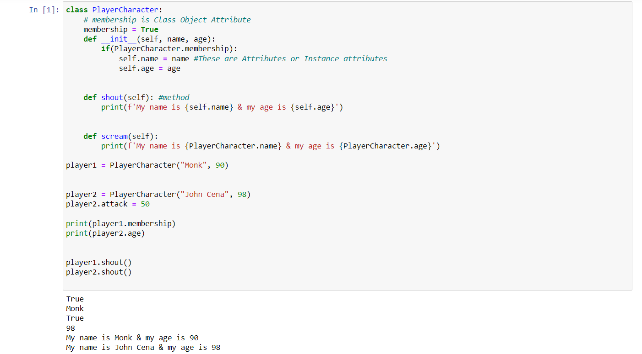

Slide 9
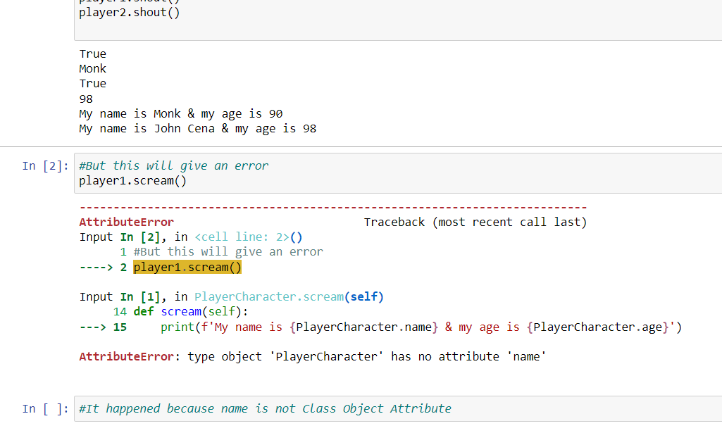

Slide 10
In Example_2, we can see that there is an class object attribute called membership. While, attribute for each object changes, it remains true for every object. Also, we can see inside __init__ that we have used conditional using “PlayerCharacter.membership”.

Slide 11
It is possible because “membership” is class object attribute. But in the later part of the example, we can see that it gives us error when we use “PlayerCharacter.name” because name is an instance attribute and is different for all objects.

Slide 12
02
@classmethod

Slide 13
Introduction
We learned that we are able to create actual attribute for a class. But what about methods? Can we do the same with methods?
Yes, we can and we use decorator “@classmethod” for this purpose. Let’s look at the example:

Slide 14
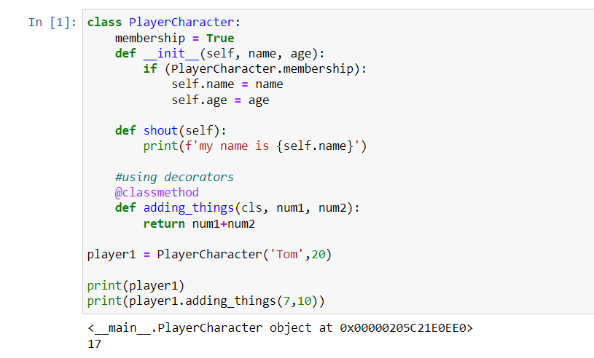

Slide 15
In Example_3, we have used “@classmethod”. While defining method as a classmethod, we must mention ‘cls’ parameter just like the ‘self’ parameter.
Plus, we can see that our object is able to access that method.

Slide 16
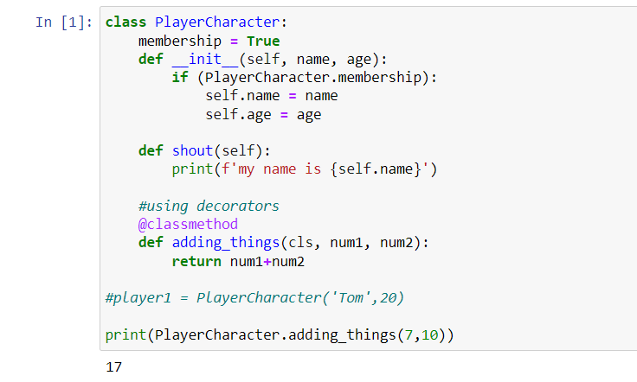

Slide 17
We can actually use this without even instantiating a class. We can see in Example_4 that the method ‘adding_things’ is called not by an object but by ‘PlayerCharacter’ just like we did with the class object attribute.

Slide 18
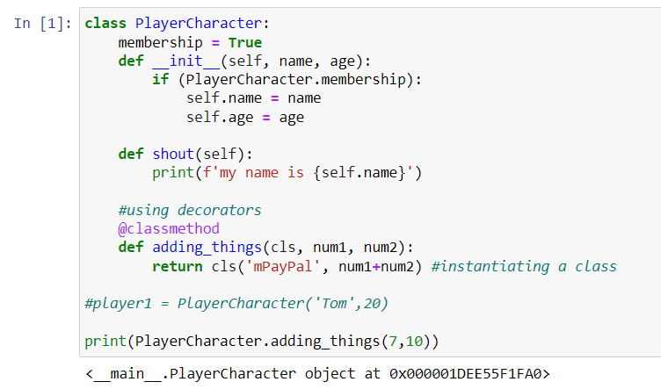

Slide 19
We can also instantiate a class using the way shown in the Example_5 where ‘cls’ represents the class.
Similarly, we can also create object as shown in Example_6:

Slide 20
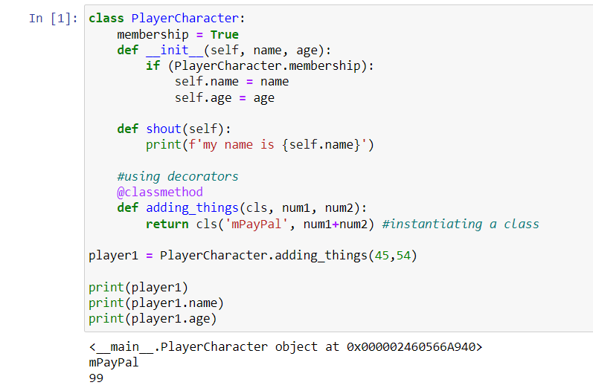

Slide 21
03
@staticmethod

Slide 22
Introduction
@staticmethod works exactly same as @classmethod, but the only difference is that we do not have access to ‘cls’. So, we can’t do something we did using @classmethod. Instead, we only perform some sort of method. We use @ststicmethod during times when we do not care about the class state.

Slide 23
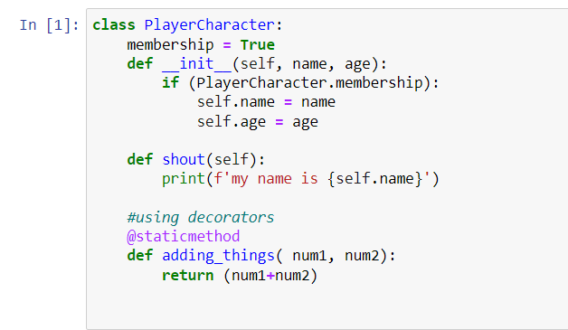
Example of @staticmethod

Slide 24
Thank You!

